Slide 1

AUTOMATIC CV EVALUATOR
PROJECT PRESENTATION
4TH YEAR (7TH SEM)
ELECTRONICS AND INSTRUMENTATION
25 OCTOBER 2024

Slide 2

TABLE OF CONTENT
01
06
Tech Stack
Motivation
02
07
Introduction
Analysis
03
What is Resume Screening
08
How does it look
04
09
Working of the project
Future Scope
05
Concept Map
10
Team

Slide 3


MOTIVATION
WHAT MOTIVATED US?
Empowering Users: Our app empowers individuals by scanning and categorizing skills from their uploaded resumes, guiding them to roles that best match their category. This streamlines the job application process, reducing effort and time by minimizing unnecessary form filling.
Fostering Career Growth: We believe that a well-crafted resume is the key to unlocking new career opportunities. Our app is designed to support users in their professional growth journey, whether they are seeking a career change, promotion, or new challenges
All the best for your placements.

Slide 4
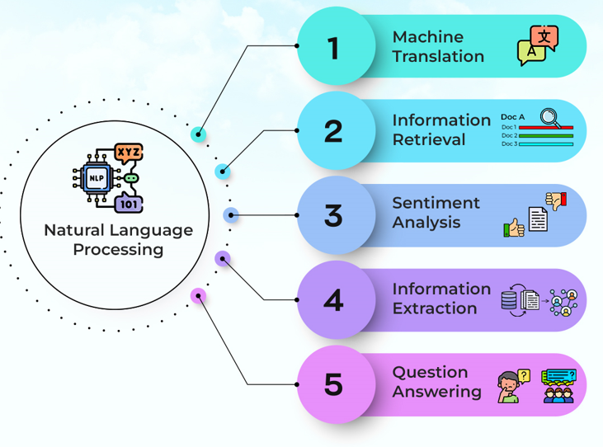
INTRODUCTION
ABOUT OUR SURVEYS AND LEARNINGS
RESEARCHED SEMANTIC MATCHING ALGORITHMS FOR JOB DESCRIPTIONS AND RESUMES:
Learnt machine learning and model training to semantic matching between resumes and job descriptions. Explored how AI-driven algorithms can analyze the content, identify key terms and phrases, and calculate match scores to evaluate candidate suitability for particular roles.
UTILIZED NATURAL LANGUAGE PROCESSING (NLP) FOR SKILL MATCHING IN RESUMES:
Applied NLP techniques to compare the skills listed in resumes with predefined skill categories. This enables the system to recommend the most suitable job roles based on the user’s qualifications and expertise.

Slide 5
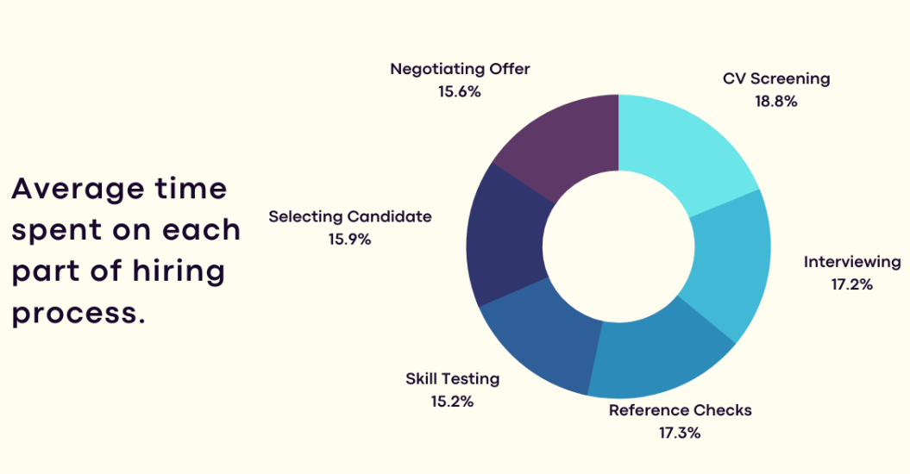
WHAT IS RESUME SCREENING
Resume screening is the process of determining whether a candidate is qualified for a role based his or her education, experience and other information captured on their resume.

Slide 6
WORKING OF THE PROJECT
HOW DOES IT WORK?
01
User Uploads Resume
03
Exploring Categories
User Interaction: The user starts by uploading their resume through the application's interface.
Resume Parsing: The uploaded resume is parsed to extract relevant sections such as skills.
Predefined Skill Categories: The system has predefined skill categories (e.g., software development, data science, marketing) with specific skills associated with each.
Skill Matching: The parsed skills from the resume are compared against these predefined categories using NLP techniques like token matching or semantic similarity. This step helps identify which job categories the user’s skills align with.
02
Data Cleaning
Remove Noise: Any unnecessary or irrelevant text (such as formatting characters, stop words, or extra spaces) is cleaned from the resume.
Standardization: Skills and text are standardized by converting to lowercase and fixing common abbreviations.

Slide 7
04
Data Vectorization
Text Vectorization: After the resume and categories are processed, both are converted into numerical vectors using techniques like TF-IDF
Feature Extraction: Key features (skills, job roles, experience) are converted into numerical data that machine learning models can process.
06
Model Training
Training the Model: A machine learning model (e.g., a classification model like Logistic Regression, Decision Trees, or advanced ones like Random Forest, XGBoost) is trained using the vectorized resume data.
Optimization: The model is fine-tuned using techniques like hyperparameter optimization to improve its performance. Metrics such as accuracy, precision, and recall are used to evaluate how well the model predicts the correct job category
05
Data Splitting
Train-Test Split: The dataset (which includes resumes and their corresponding categories) is divided into a training set and a testing set, typically in an 80-20 or 70-30 ratio. This helps the model learn from one part and validate against another.

Slide 8
07
08
Prediction
Front-end Integration
Real-Time Prediction: When a new resume is uploaded, the trained model predicts which job category or role is best suited for the user based on the skills mentioned in their resume.
Score Generation: The system may also generate a match score, showing how well the user’s resume fits into each job category. Higher scores mean better matches. This feature is still under process.
Syncing Results: The results (predicted job roles and score) are sent back to the frontend, where the user can see their matching categories.
User Feedback: Along with category suggestions, the system might provide feedback, such as improving the resume by adding certain skills to better fit a desired category or correcting grammar issues.

Slide 9


Dividing the dataset into training and testing subsets to build and evaluate the performance of the model.
Converting text data (like resume content) into numerical format so that machine learning models can process it.
CONCEPT MAP
Using algorithms to learn from the training data and then predicting suitable job roles based on the uploaded resume
Removing irrelevant or erroneous data from resumes to ensure accurate processing and analysis.
Vectorization
Splitting
Model training and prediction
Cleaning
Data
Connect the code to the frontend for user friendly process and uploading the Resume
Analyzing and comparing skills in uploaded resumes with predefined categories to identify the most relevant job roles.
Exploring categories and resume
Home page and app Sync

Slide 10

TECH STACK AND LIBRARIES
WHAT WE USED?
MACHINE LEARNING
NLP
PANDAS
MATPLOTLIB
NUMPY
SEABORN
PICKLE
SKLEARN
STREAMLIT

Slide 11
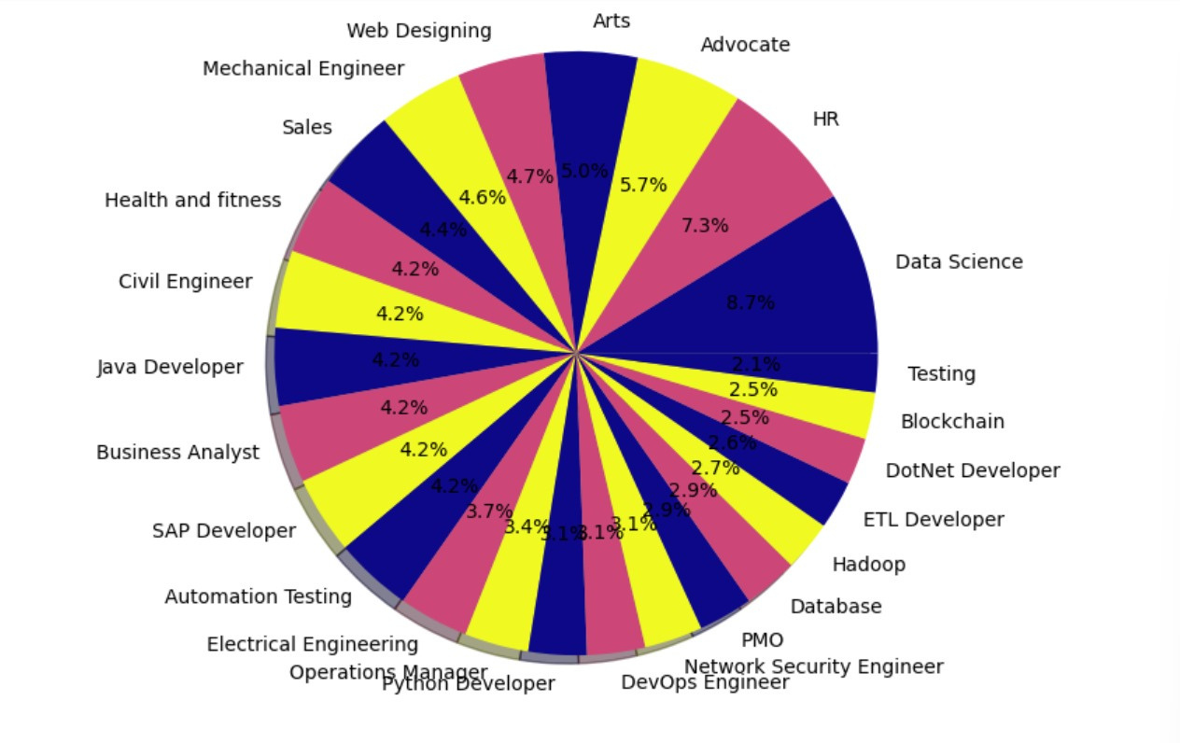
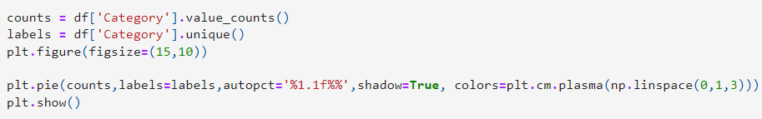
ANALYSIS
EDA: EXPLORATORY DATA ANALYSIS
CONDUCTED ANALYSIS BY EXPLORING CATEGORIES: VISUALIZED THE DATA BY PLOTTING CATEGORY NAMES ON THE X-AXIS AND THEIR UNIQUE COUNTS ON THE Y-AXIS. THE INSIGHTS WERE REPRESENTED USING BOTH PIE AND BAR CHARTS, HIGHLIGHTING THE DISTRIBUTION OF SKILLS ACROSS DIFFERENT CATEGORIES.

Slide 12
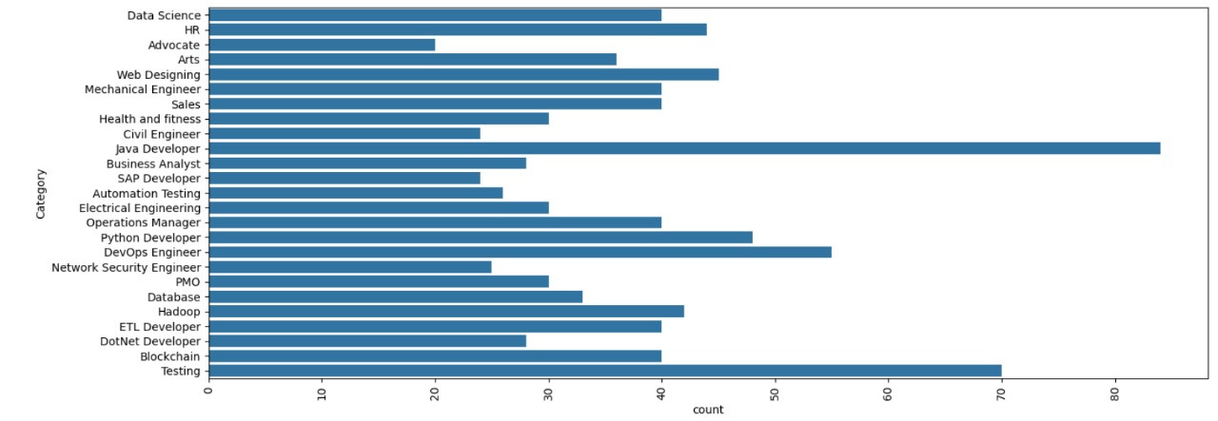
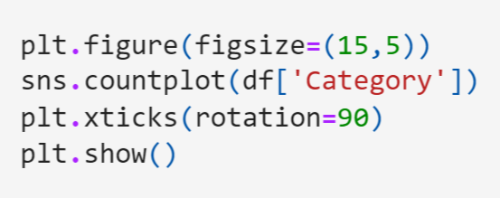
STATISTIC
Thynk Unlimited

Slide 13
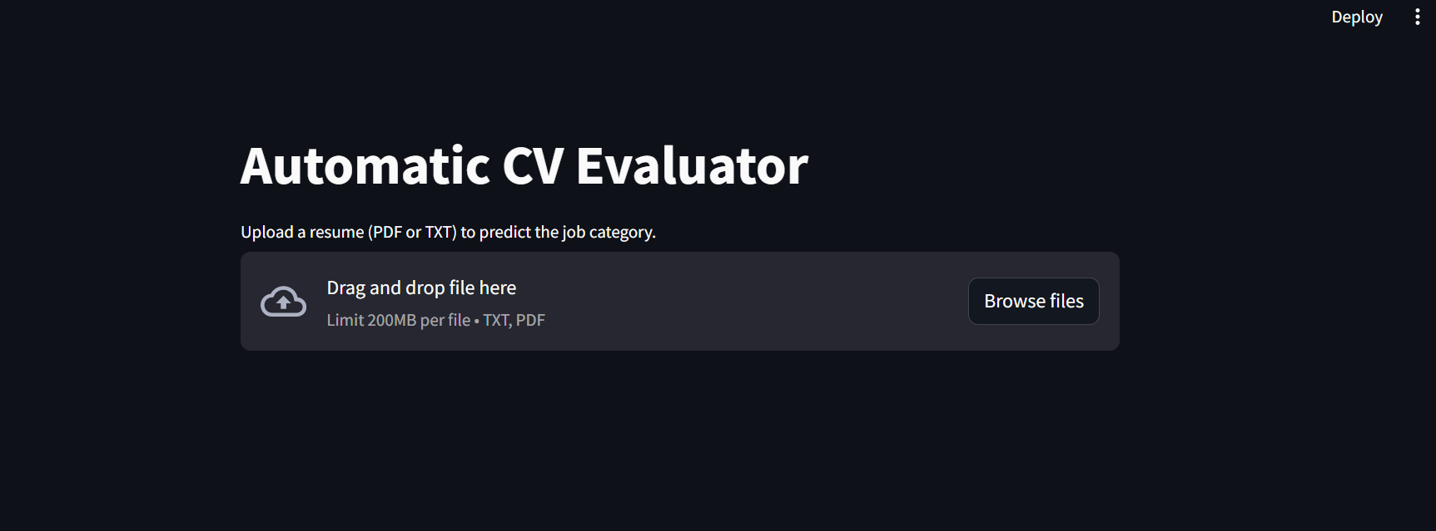
HOW DOES IT LOOK ?
FEATURES
Browse your file
Upload text or pdf file
category displayed after selecting your file
Multiple file selection option.

Slide 14
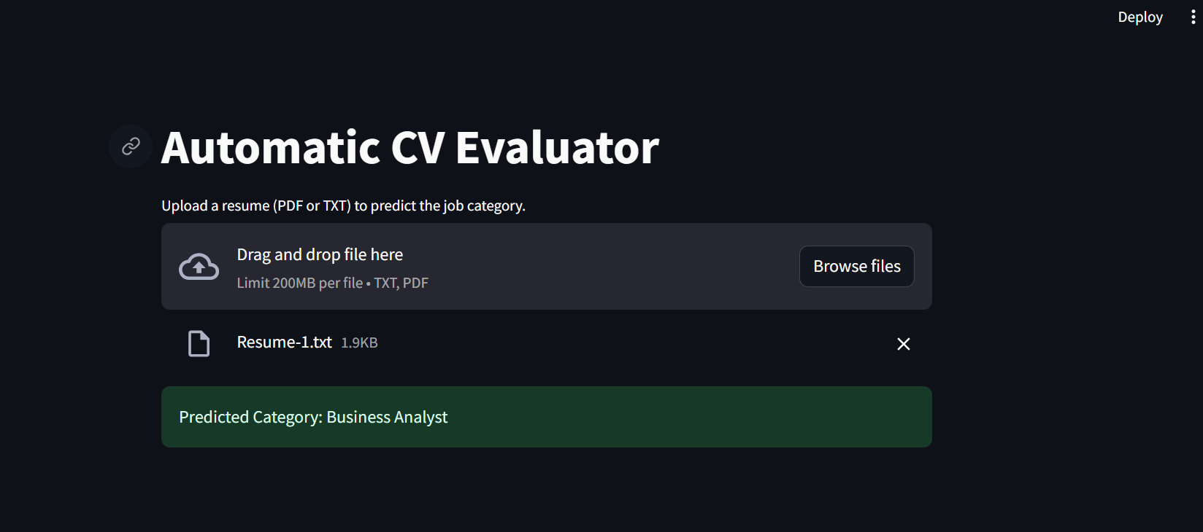
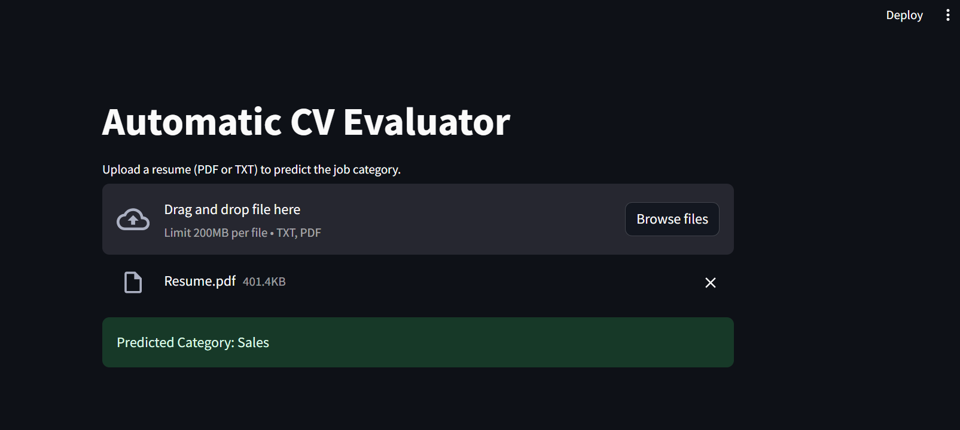
WORKING EXAMPLE

Slide 15


FUTURE SCOPE
Enhanced Skill Matching Accuracy
Personalized Job Role Suggestions
Integration with Real-time Job Market Trends
Automated Resume Optimization
Leverage advanced NLP models to improve the accuracy of matching skills in user resumes with predefined categories, ensuring more precise role recommendations
Implement machine learning algorithms to predict the most suitable job roles based on individual skills and career history, providing tailored recommendations to users.
Incorporate dynamic updates from job market trends, adjusting role suggestions based on in-demand skills and emerging categories, helping users stay competitive. Also, generate a score.
Use NLP-driven insights to suggest improvements to users' resumes, optimizing their content to better align with targeted job categories and improve matching success. Also, grammar correction.

Slide 16




TEAM MEMBER HIGHLIGHTS
Get to know our team
Anushka Panse
21E7010
Nirjhara Srivastava
21E7039
Agam Jain
21E7005
Aryan Vyas
21E7012

Slide 17
THANK YOU
FOR YOUR NICE ATTENTION
25 OCTOBER 2024

